Slide 1
Psalm 49
To the choirmaster. A Psalm of the Sons of Korah.

Slide 2
¹ Hear this, all peoples!
Give ear, all inhabitants of the world,
² both low and high,
rich and poor together!
³ My mouth shall speak wisdom;
the meditation of my heart shall be understanding.
⁴ I will incline my ear to a proverb;
I will solve my riddle to the music of the lyre.

Slide 3
⁵ Why should I fear in times of trouble,
when the iniquity of those who cheat me surrounds me,
⁶ those who trust in their wealth
and boast of the abundance of their riches?
⁷ Truly no man can ransom another,
or give to God the price of his life,
⁸ for the ransom of their life is costly
and can never suffice,
⁹ that he should live on forever
and never see the pit.

Slide 4
¹⁰ For he sees that even the wise die;
the fool and the stupid alike must perish
and leave their wealth to others.
¹¹ Their graves are their homes forever,
their dwelling places to all generations,
though they called lands by their own names.
¹² Man in his pomp will not remain;
he is like the beasts that perish.

Slide 5
¹³ This is the path of those who have foolish confidence;
yet after them people approve of their boasts. Selah
¹⁴ Like sheep they are appointed for Sheol;
death shall be their shepherd,
and the upright shall rule over them in the morning.
Their form shall be consumed in Sheol, with no place to dwell.
¹⁵ But God will ransom my soul from the power of Sheol,
for he will receive me. Selah

Slide 6
¹⁶ Be not afraid when a man becomes rich,
when the glory of his house increases.
¹⁷ For when he dies he will carry nothing away;
his glory will not go down after him.
¹⁸ For though, while he lives, he counts himself blessed
—and though you get praise when you do well for yourself—
¹⁹ his soul will go to the generation of his fathers,
who will never again see light.
²⁰ Man in his pomp yet without understanding is like the beasts that perish.

Slide 7
²⁰ Man in his pomp yet without understanding is like the beasts that perish.
Self confidence, based on strength; wealth; inheritance; position; power... ends in death

Slide 8
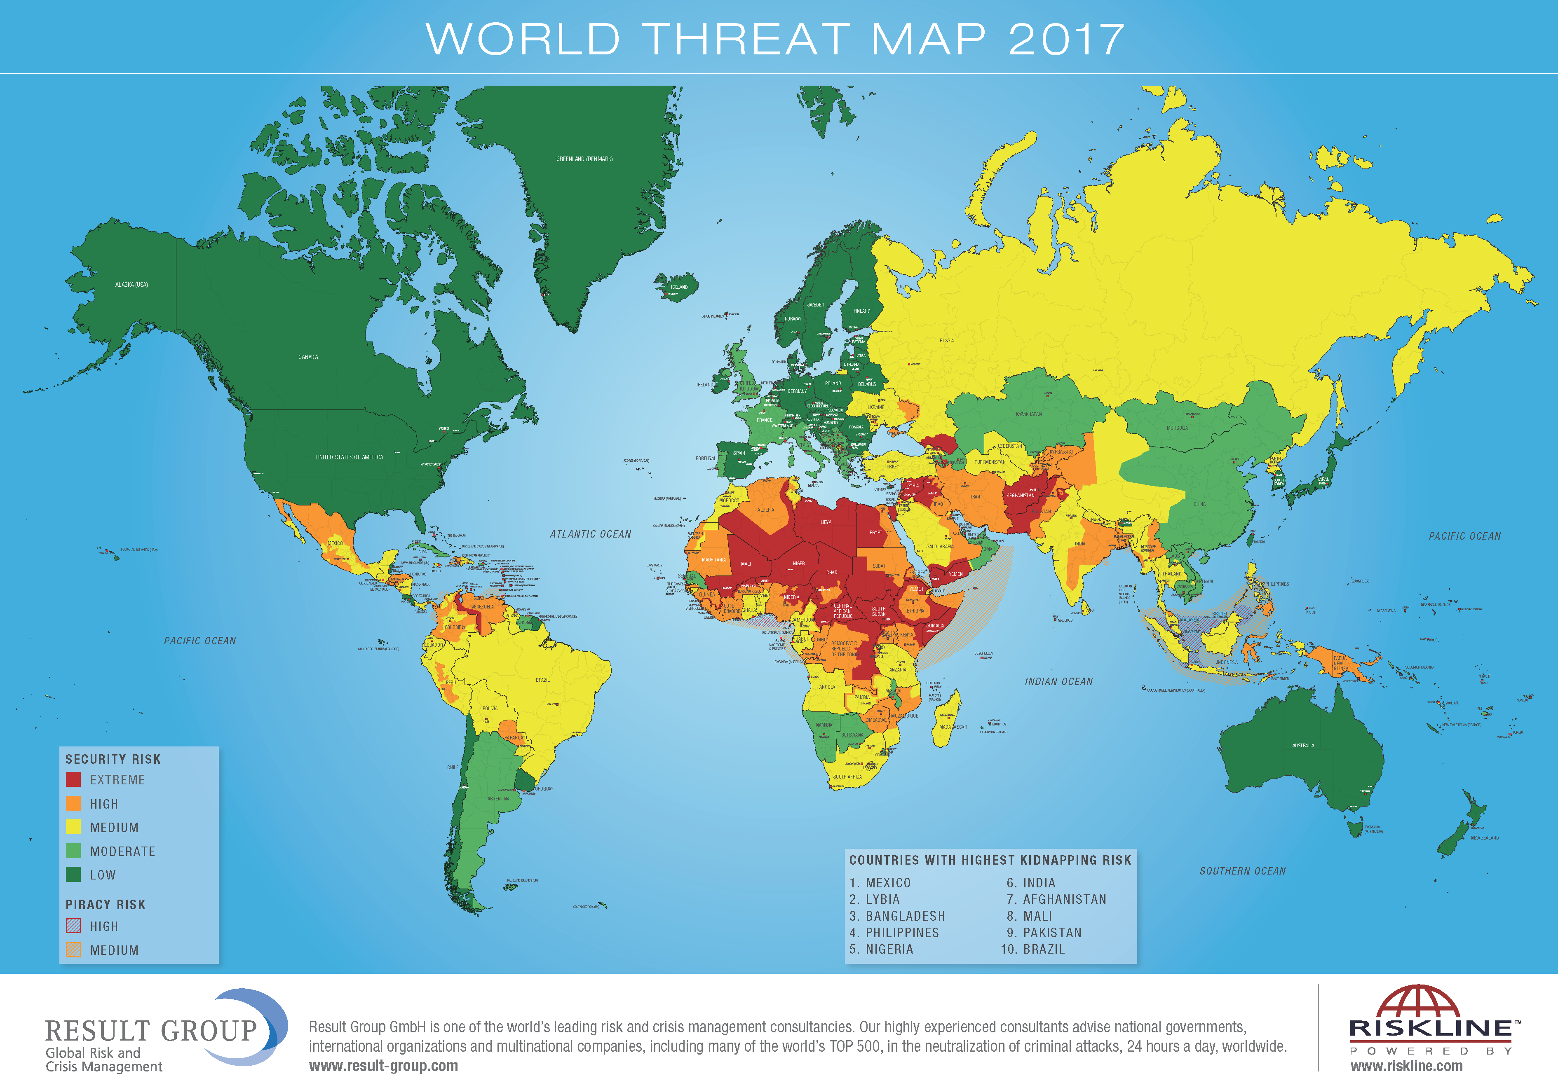

Slide 9
²⁰ Man in his pomp yet without understanding is like the beasts that perish.
Self confidence, based on strength; wealth; inheritance; position; power... ends in death
No man can afford a ransom to release us from death
¹⁵ But God will ransom my soul from the power of Sheol,
for he will receive me.
Mark 10:⁴⁵ For even the Son of Man came not to be served but to serve, and to give his life as a ransom for many.”

